Slide 1

NeuroDOT Tutorial: Participant Specific Head Modeling

Slide 2

Diffuse Optical Tomography
In diffuse optical tomography (DOT), arrays of optical sources and detectors are used to perform functional neuroimaging experiments on task-based or resting state modes of human brain function.
Analyses are broken into several pipelines:
B: modeling of the tissue shape, optical property distribution, and source/detector locations
C: modeling of the light emission, diffusion, and detection through the head
D: preprocessing of the raw source-detector measurements
E: reconstruction and spectroscopy of the preprocessed data and light model into a functional neuroimaging volume
F: post-processing analysis of these results.
A head model based on the MNI152 atlas included with NeuroDOT. The additional processing required to generate a participant-specific head model is presented in this tutorial.

Slide 3
Participant Specific Head Modeling
Set up directories
This tutorial will follow the Script_for_Participant_Specific_Head_Modeling.m
In this tutorial you will complete:
Head segmentation and data registration with FreeSurfer
Unpack FreeSurfer outputs
Segment the head with NeuroDOT
Computational head mesh generation and array alignment
Make low and high density meshes
Use AlignMe to align the array with the mesh
Relax optodes on the head mesh and save relaxed optode positions
Remove unused nodes from mesh for computational efficiency
Model light diffusion in the head and calculate, visualize, and validate the sensitivity profile
Make “A” sensitivity matrix with NIRFASTer
Package data and save with “A”
Make the flat field reconstruction
Visualize the sensitivity profile
We will use the LUMO visual pad as an example: Pad_LUMO_adult_visual.mat
Head Segmentation
& Data Registration
6-20 hours
Mesh Generation
30-40 minutes
Array Alignment
Light Modeling
~10 minutes
Validate Sensitivity

Slide 4
Dependencies
This tutorial utilizes requires the following linked software packages:
FreeSurfer 7.2.0
Connectome Workbench – used for fsLR alignment
Gifti toolbox
NIRFASTer
The Standard_mesh_atlases folder is required for running the fsLR script, downloadable from HCPpipelines on GitHub.
FreeSurfer 7.2.0 is only compatible with Linux OS (CentOS6, OS7, OS8, and Ubuntu18) and Mac OSX (10.12 thru 10.15, 11.X)
This tutorial and it’s accompanying script are optimized for Matlab version R2020b

Slide 5
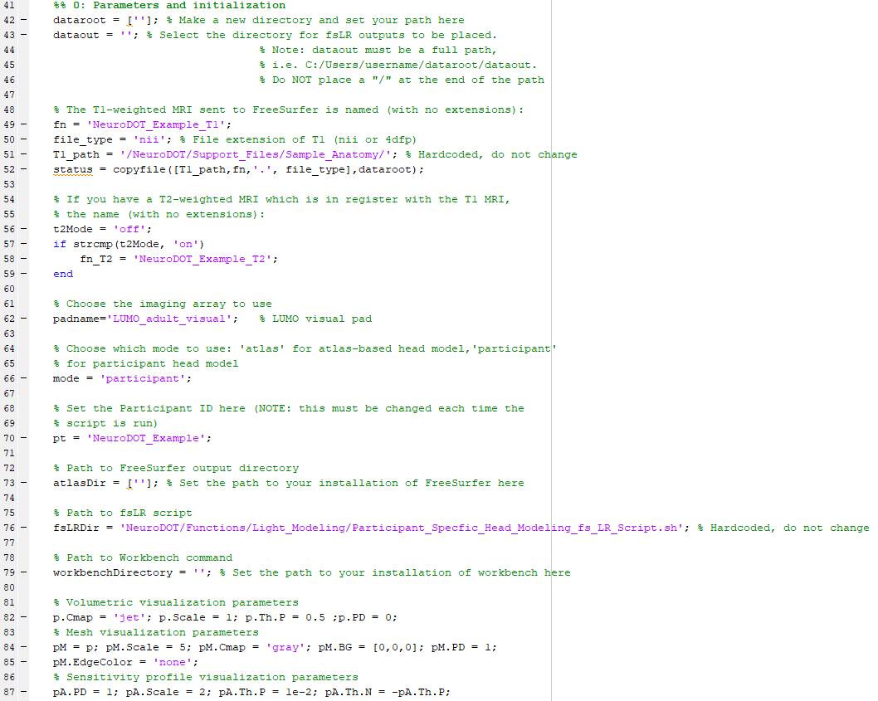
Directory Organization: Required Directories
Required directories:
Participant MRI directory (dataroot)
fsLR output directory (dataout)
Participant FreeSurfer output directory (atlasDir)
fsLR code directory (fsLRDir)
Workbench Installation directory (workbenchDirectory)
Standard_mesh_atlases
The path to each of these directories must be specified at the beginning of the script (Section 0: Parameters and initialization)
Instructions for setting each path or directory will be detailed in the following slides.

Slide 6
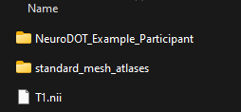
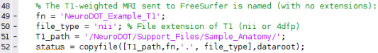
Set-Up Directories: dataroot
Setting up the dataroot folder
Create an empty folder to save all outputs from this tutorial in
Set dataroot to the path to this folder and run line 42
This path MUST have a ‘/’ at the end of it
Move the Standard_mesh_atlases folder from HCPpipelines-master/global/templates to this folder
Add a new folder whose name matches the participant ID to this folder
The participant ID for this tutorial is: NeuroDOT_Example_Participant
Run lines 49-52 which copies the T1 file for this tutorial into the dataroot folder
Note: if you are running your own data for this tutorial, steps 4 and 5 will be different
Alternate Step 4: set the participant ID according to the participant you’re using
Alternate Step 5: do not run lines 49-52. Simply put the T1 for the participant you’re using in the dataroot folder
Dataroot folder should look like this after steps 1-5 are completed

Slide 7
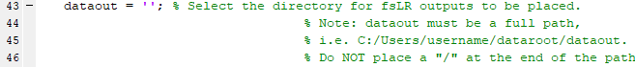
Set-Up Directories: dataout
dataout
Create an empty folder you can move files to later.
We recommended that this folder is made within the folder used as dataroot.
dataout must be an absolute path.
Do not place a "/" at the end of the dataout.
Note: dataout will be the fsLR output folder
A subfolder named fs_LR will be created within this folder once fsLR completes
Set dataout to the path to this folder.

Slide 8
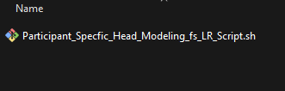
Set-Up Directories: atlasDir and fsLRDir
atlasDir
Specify the full path to the FreeSurfer subjects folder in the FreeSurfer installation directory on your computer
fsLRDir
Specify the full path to the folder where the file: “Paricipant_Specific_Head_Modeling_fs_LR_Script.sh” is located
This file is in the Documentation/Scripts folder of the NeuroDOT toolbox

Slide 9
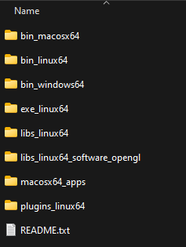
Set-Up Directories: workbenchDirectory
workbenchDirectory
Set this variable to the path to your Connectome Workbench installation folder
The name should end in “/bin_linux64/” if you are using Linux, “/bin_windows64/” for Windows, or “/bin_macosx64/” for Mac OS. For example, if using Linux, line 79 would read something like:
workbenchDirectory = ’/path/to/workbench/bin_linux64’

Slide 10
Participant Specific Head Modeling Pipeline
You can generate a participant head model in NeuroDOT using a T1 MRI scan.
If you have a T2 registered to the T1 scan, you can also utilize the T2 in your head model.
Set up directories
Head Segmentation
& Data Registration
Mesh Generation
Array Alignment
Light Modeling
Validate Sensitivity

Slide 11
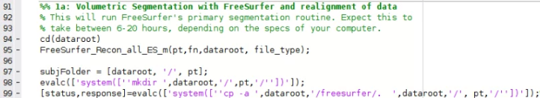
Prepare for & Run FreeSurfer
Before running FreeSurfer, ensure that you have installed FreeSurfer version 7.2.
The NeuroDOT function FreeSurfer_Recon_all will be used to call FreeSurfer 7.2.
The required inputs are:
Participant ID (pt)
You must use a unique participant ID each time, or delete all previous results before re-running for the same subject
The filename of your T1data file (fn)
The path to your MRI (dataroot)
The type of file, which can be either ‘4dfp’ or ‘nii’ (file_type)
FreeSurfer_Recon_all will take 6-20 hours to run, depending on your computer.

Slide 12
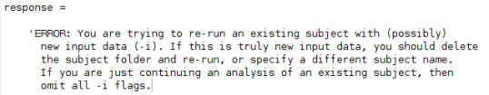
Potential FreeSurfer Error
Re-running existing subject error
This error occurs when you try to run FreeSurfer on a participant for whom you have already run FreeSurfer on
If you encounter this error, go to the subjects folder in the directory where FreeSurfer is installed on your computer and delete the folder named by the variable ‘pt’ in your workspace.
For example, if the error occurs while running this tutorial you would delete the folder: freesurfer/subjects/NeuroDOT_Example

Slide 13
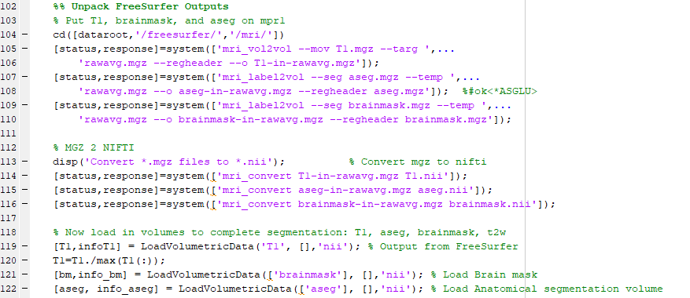
Unpack FreeSurfer Outputs
Once FreeSurfer has finished running, unpack the outputs:
Put the T1, brainmask, and aseg volumes in the space of ‘mpr1’ (the original T1 MRI)
Convert the .mgz files to NIfTI (.nii)
Load the volumes and normalize

Slide 14
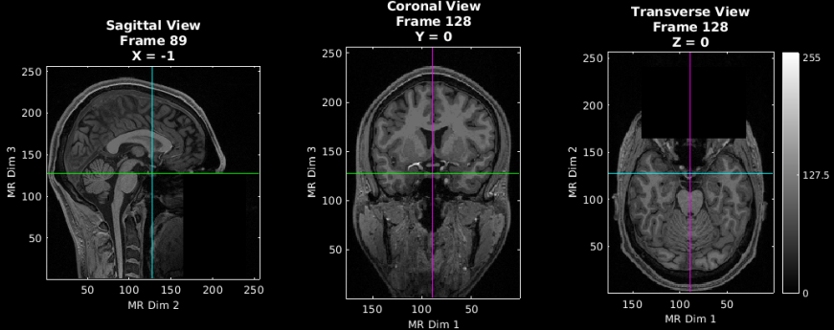
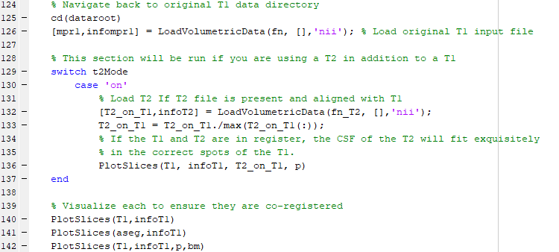
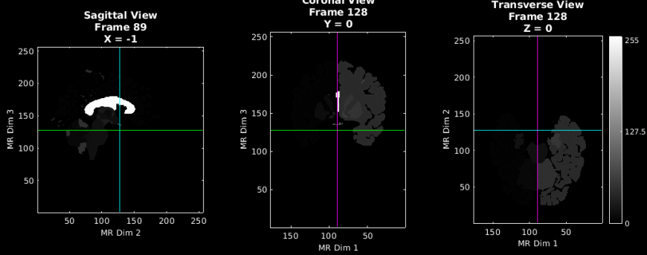
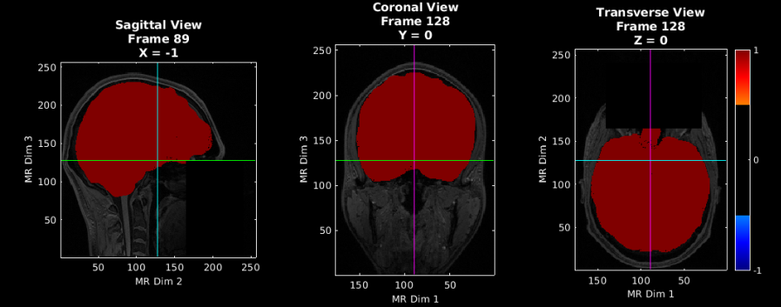
Unpack FreeSurfer Outputs
T1.nii
Visualize the FreeSurfer outputs using PlotSlices:
aseg.nii
T1.nii with brainmask.nii as overlay in red

Slide 15
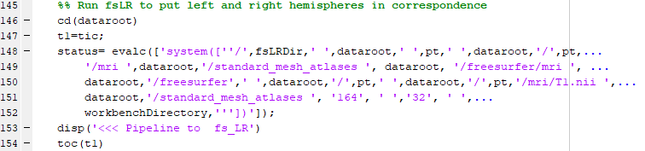
Align the volume and cortex using ‘fsLR’
The fsLR script will take ~350-400s to complete
Note: If less than 350-400s has elapsed while running fsLR, check your paths and try again. You can otherwise tell if any errors occurred by checking if there are any files in the fsLR output directory. If the script was successful, the output directory will be populated.

Slide 16
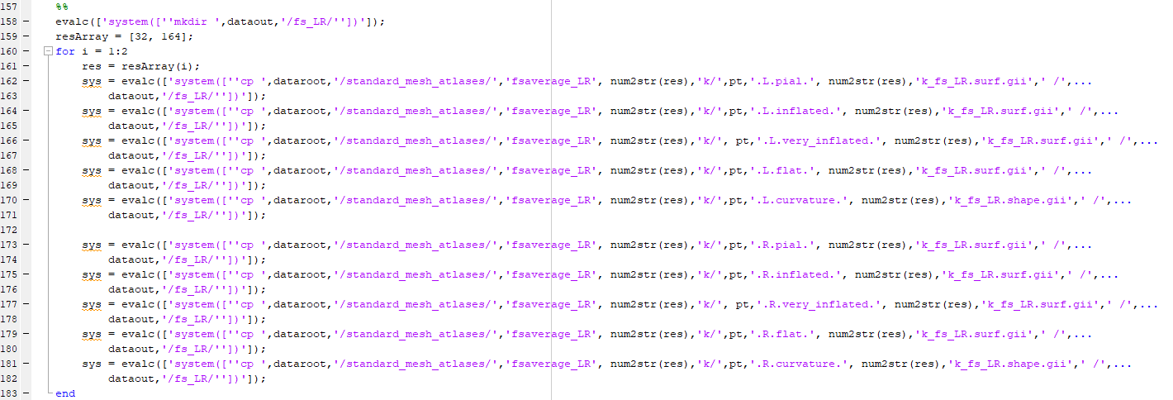
Align the volume and cortex using ‘fsLR’
Run lines 157-183, which move the fsLR script outputs to your Output Directory “dataout”

Slide 17
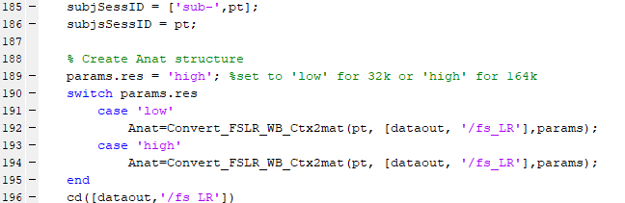
Aligning the volume with the cortex using ‘fsLR’
To complete processing, use Convert_FSLR_WB_Ctx2mat to add pial, inflated, very Inflated, and flat surfaces to the Anat structure.

Slide 18
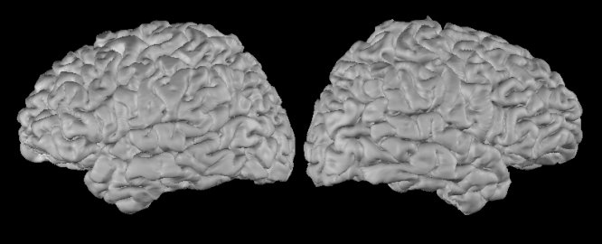
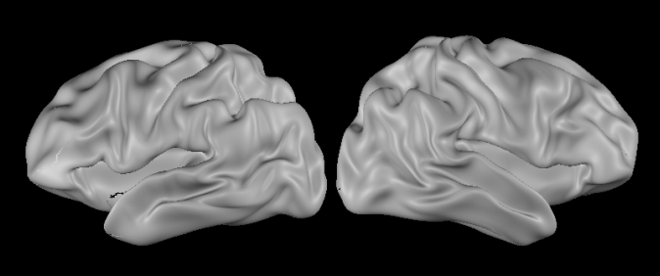
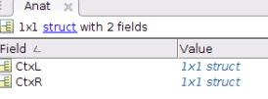
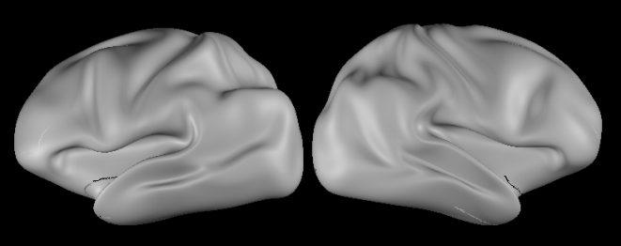
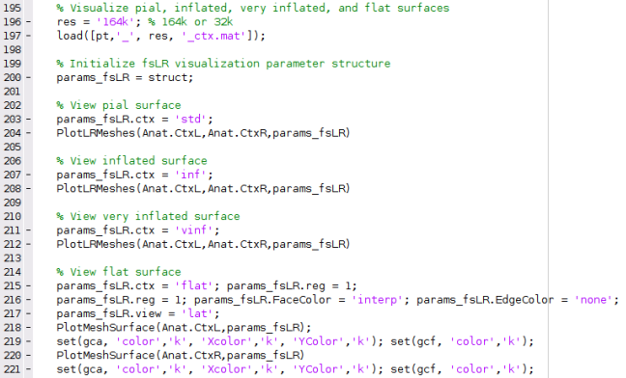
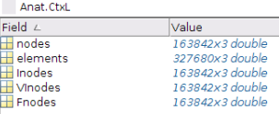
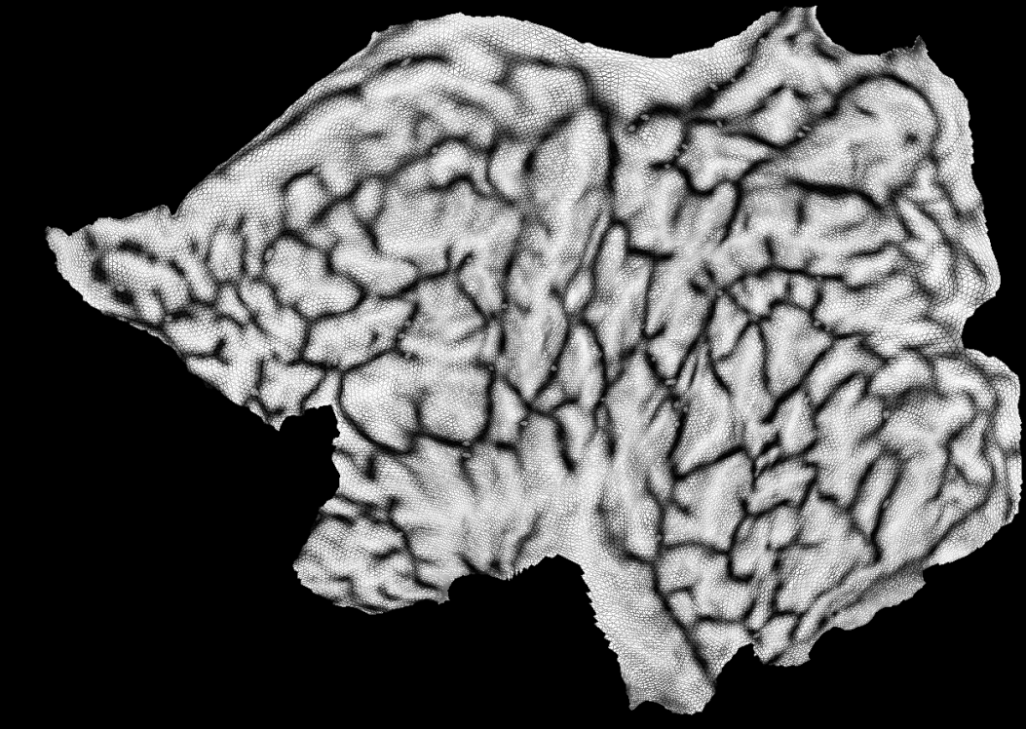
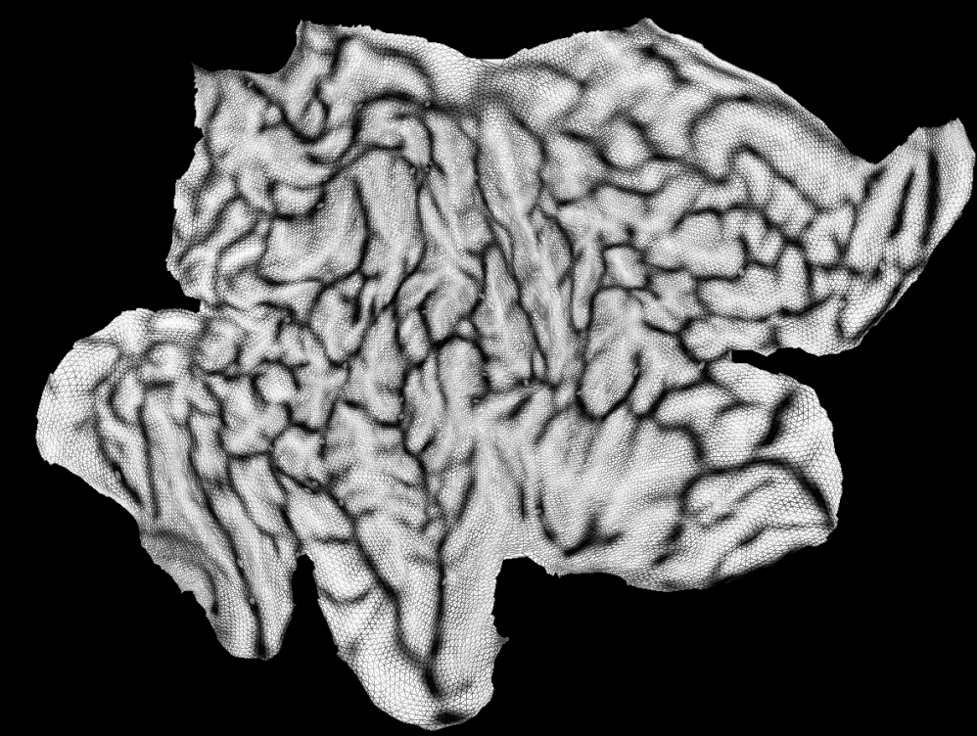
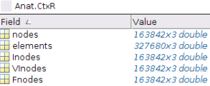
Visualize fsLR Outputs
Pial
Use PlotLRMeshes to visualize the following surfaces:
Pial
Inflated
Very Inflated
Flat
Inflated
Example Mesh
Structure
Very Inflated
Flat

Slide 19
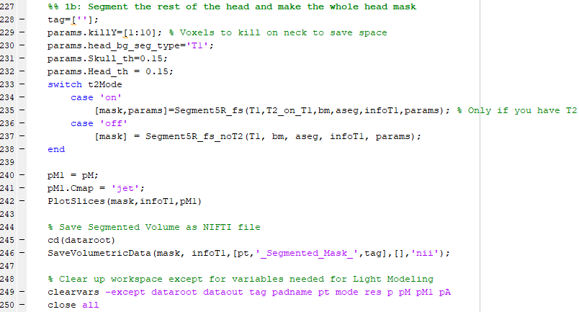
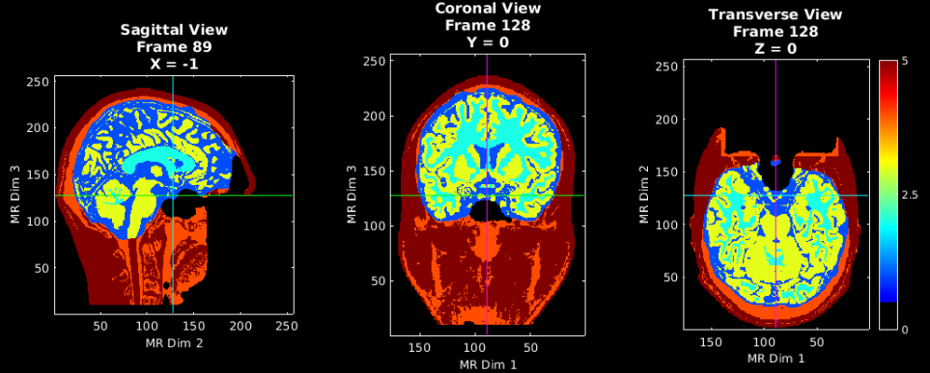
Segment the head and make a mask
Use NeuroDOT to segment the head and make the whole head mask
Call Segment5R_fs if you have both T1 and T2 images
Call Segment5R_fs_noT2 if you only have a T1 image

Slide 20
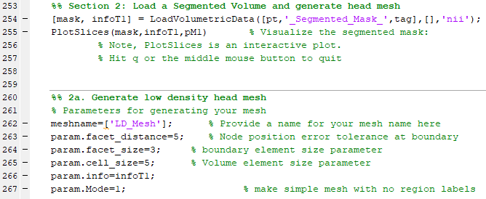
Prepare for low-density head mesh
Parameters
Facet_distance = error tolerance at boundary for node positions
Facet_size = size of surface triangles of mesh
Cell_size = size of internal tetrahedra
Set up directories
Head Segmentation
& Data Registration
Mesh Generation
Array Alignment
Light Modeling
Validate Sensitivity

Slide 21
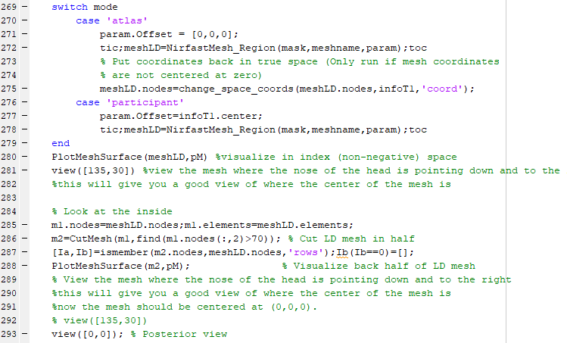
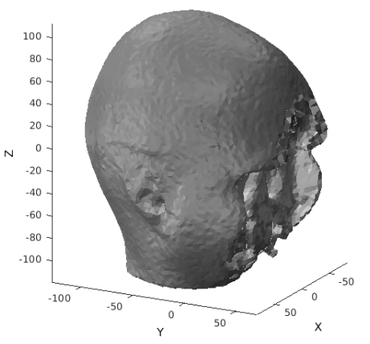
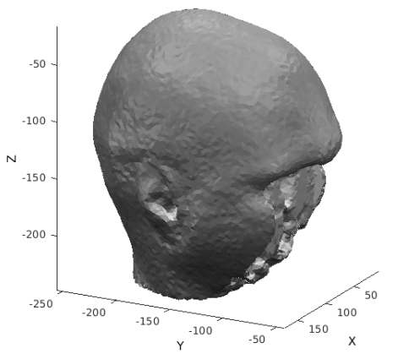
Generate low-density head mesh in coordinate space
For atlas-based head models:
Param.Offset is set to [0,0,0] to be input when generating the head mesh
Change_space_coords is used to place the mesh in coordinate space
For participant-specific head models:
Param.Offset is set to equal the center of the volume, infoT1.center
In “coordinate space”, the origin is located in the center of volume
“index space”
is non-negative

Slide 22
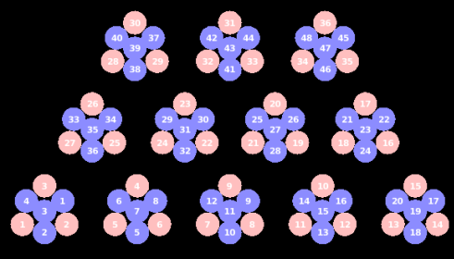
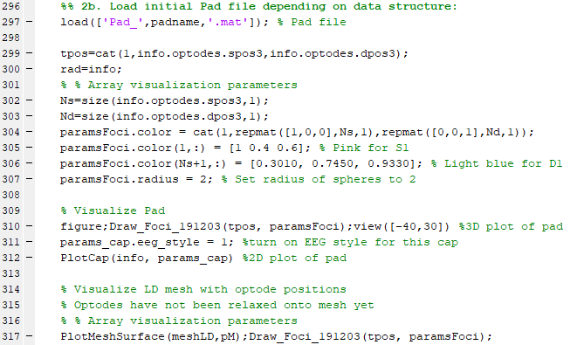
Load the initial pad file
Set up directories
For this tutorial, the LUMO Visual Pad will be used.
36 sources and 48 detectors
Head Segmentation
& Data Registration
Mesh Generation
Array Alignment
Light Modeling
Validate Sensitivity

Slide 23
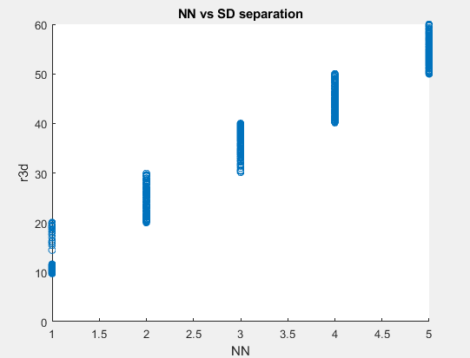
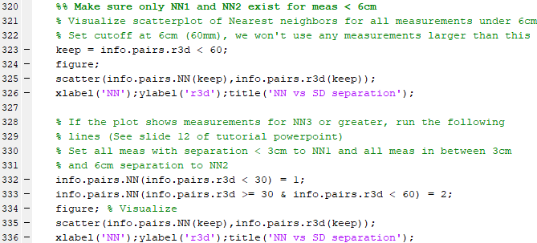
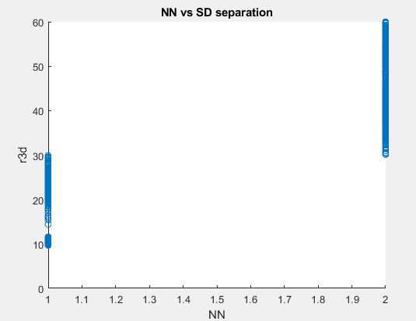
Check nearest-neighbor classifications
Make sure only NN1 and NN2 exist for measurements < 6cm

Slide 24
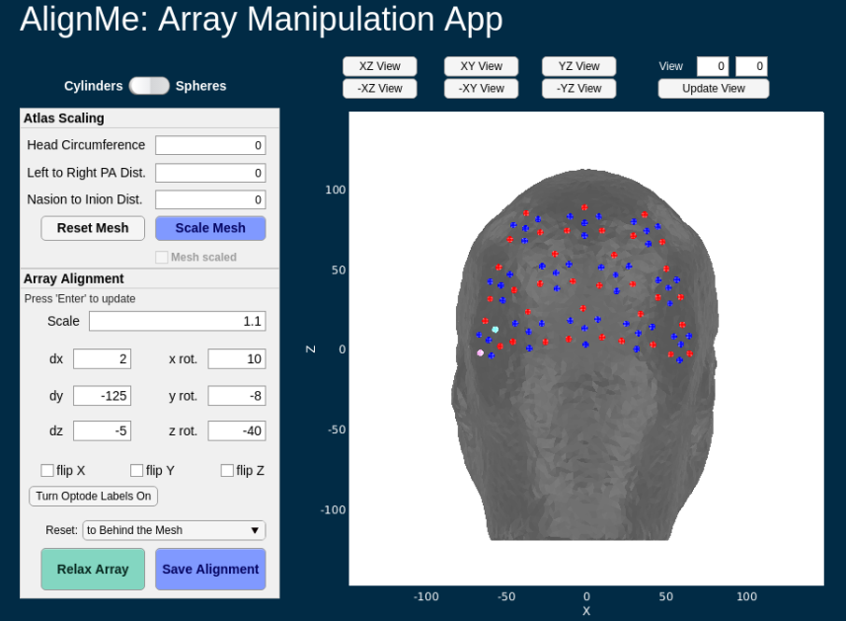
Place fNIRS array on the low-density mesh
Set up directories
Run Section 2b-c, lines 339-373 to launch the AlignMe application
For an in-depth tutorial on how to use AlignMe, check out “NeuroDOT_Tutorial_AlignMe.pptx” in Documentation/Tutorials
Head Segmentation
& Data Registration
Mesh Generation
Array Alignment
Light Modeling
Validate Sensitivity

Slide 25
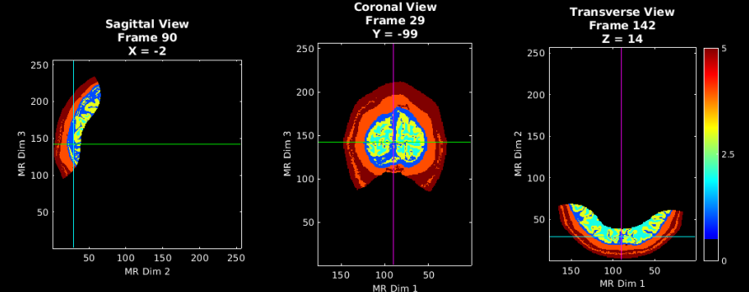
Prepare for high density mesh generation
Create simplified mesh by cropping based on the relaxed optode locations.

Slide 26
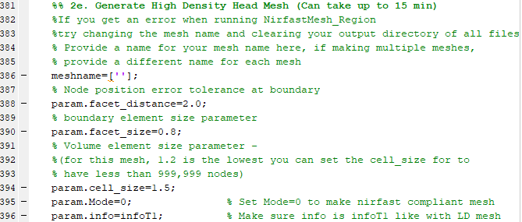
Prepare for high density mesh generation
Set up directories
Parameters
Facet_distance = error tolerance at boundary for node positions
Facet_size = size of surface triangles of mesh
Want to keep this as small as possible for the surface to be highly faceted
Cell_size = size of internal tetrahedra
This can be changed depending on if the total number of nodes in the mesh is > 999,999
Head Segmentation
& Data Registration
Mesh Generation
Array Alignment
Light Modeling
Validate Sensitivity

Slide 27
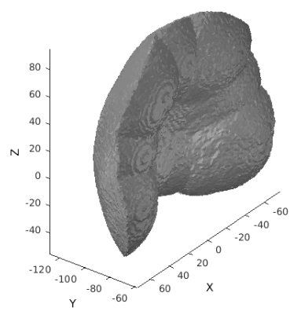
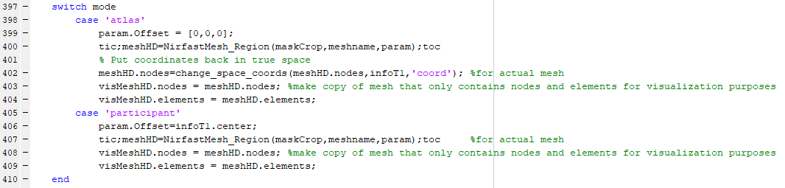
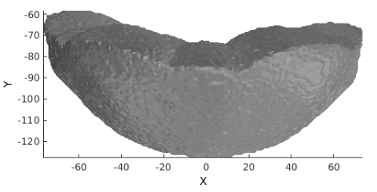
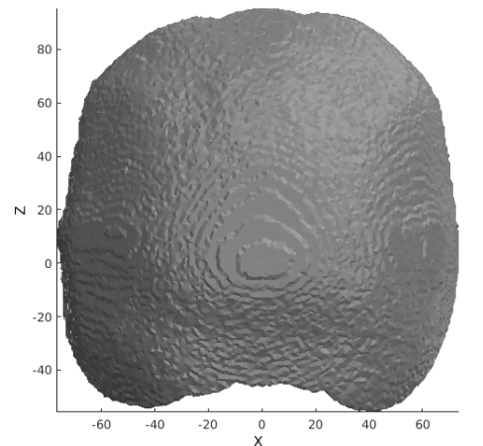
Generate high-density mesh

Slide 28
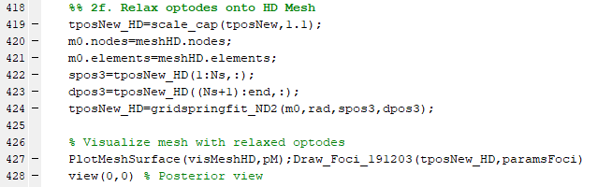
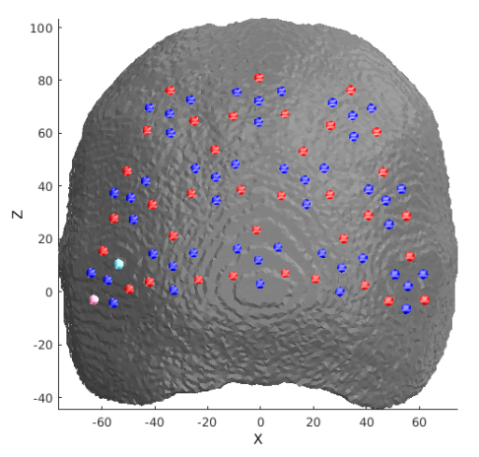
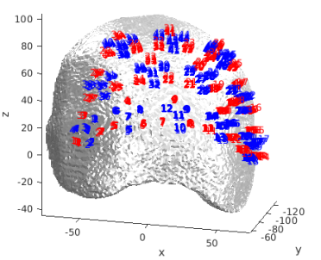
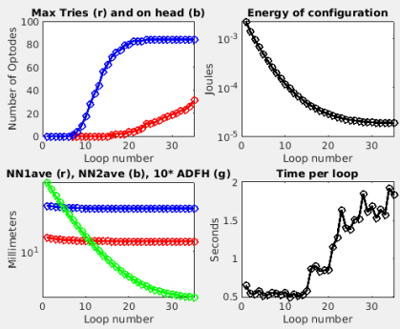
Relax optodes on the high-density mesh

Slide 29
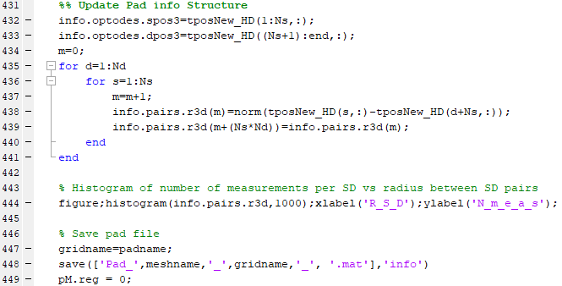
Update Pad Info Structure

Slide 30
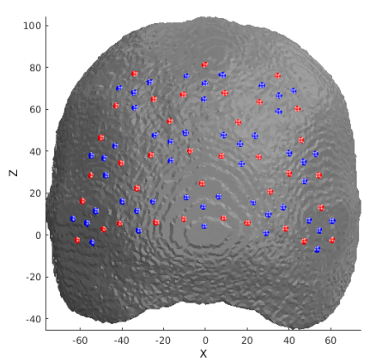
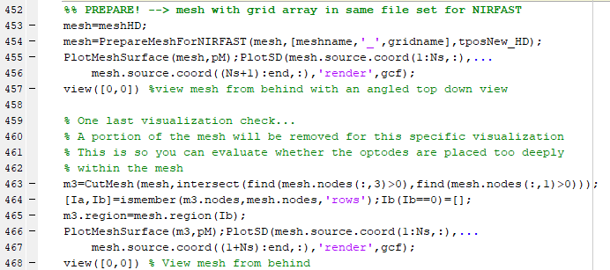
Generate NIRFAST compliant mesh
Prepare high-density mesh for NIRFAST
Combine high-density mesh and grid array into a single mesh

Slide 31


Generate sensitivity “A” matrix
Set up directories
Head Segmentation
& Data Registration
Set parameters for light modeling and run “makeAnirfaster”
Mesh Generation
Array Alignment
Light Modeling
Validate Sensitivity

Slide 32

Package Metadata and Save A

Slide 33

Update bookkeeping in A to save space and align with system data

Slide 34


Validate sensitivity 1
Visualize a single source detector pair: Source 1, Detector 24
Set up directories
Head Segmentation
& Data Registration
Mesh Generation
Array Alignment
Light Modeling
Validate Sensitivity

Slide 35


Validate sensitivity 2
Generate the flat field reconstruction and visualize.
Set up directories
Head Segmentation
& Data Registration
Mesh Generation
Array Alignment
Light Modeling
Validate Sensitivity

Slide 36





Visualize Flat Field Reconstruction on the Surface

Slide 37



Visualize alignment of array, head mesh, and cortex

Slide 38

You have reached the end of the tutorial.
Now, you have a completed anatomical head model and light model for a single participant.
Next, you can use these results to process your fNIRS data and perform mapping of brain function in the following tutorials:
Loading raw data
Preprocessing
Image Reconstruction
Full Data Processing
Please consult the documentation on the NeuroDOT NITRC and GitHub pages, or contact the developers:
neurodot-support@wustl.edu

